Slide 1
The Shape of Data
In data science most of the data encountered is in tabular format, e.g. our tennis data set.
We call this kind of data structured data.
As opposed to unstructured data which usually appears in the form of text, e.g. medical reports, news articles.
In this course we will take a look at both. We will start with structured data.

Slide 2
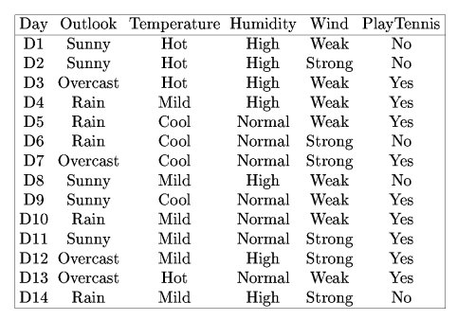
Structured Data
Structured data consists of tables where
each column describes an attribute of the data objects in question. We often call the columns variables or attributes.
Each row describes a single observation or data object.
For example, in our tennis data set each row describes a day in terms of its attributes (columns).

Slide 3
Data Types
The columns are usually associated with a particular data type:
Numerical, attribute always has order.
Discrete – integer values representing counts of some entity (e.g. number of doctor visits, age)
Continuous – usually represent measurements of some sort (e.g. height, distance)
Categorical, attribute that only has labels as its values.
Ordinal (order) – labels that represent some sort of hierarchy (e.g. Low < Medium < High)
Nominal (names) – labels that represent distinct categories (e.g. Yes/No or True/False)

Slide 4
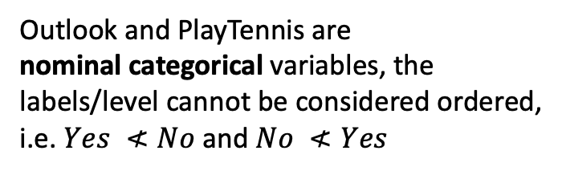

Variables
All of the variables in this data set are categorical variables – variables whose values only consist of labels/levels.
Outlook and PlayTennis are nominal categorical variables, the labels/level cannot be considered ordered, i.e. $Yes ≮No$ and $No ≮Yes$
The remaining variables are all ordinal categorical variables – the labels/levels can be considered ordered, i.e. $Cool <Mild<Hot$

Slide 5
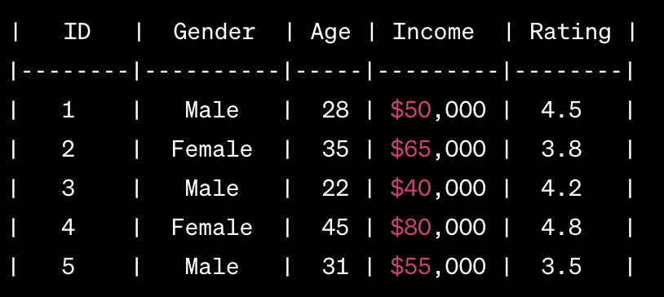
ID: Discrete numerical variable representing a unique identifier for each individual.
Gender: Nominal categorical variable representing the gender of the individual (Male/Female).
Age: Discrete numerical variable representing the age of the individual.
Income: Continuous numerical variable representing the income of the individual.
Rating: Continuous numerical variable representing a rating given by the individual.
Note: We see later that we will treat numerical ID variables like they appear in this table as nominal categorical variables because it makes no sense to use these identifiers as numerical values, we cannot order them or do mathematical transformations on them.

Slide 6

Real-World Data is Noisy
https://www.slideshare.net/dataremixed/17-key-traits-of-data-literacy

Slide 7

The Effects of Noisy Data
A marketing firm was tasks to determine how Volkswagen ranks among the top brands
They found a lot of misspellings of the name Volkswagen

Slide 8
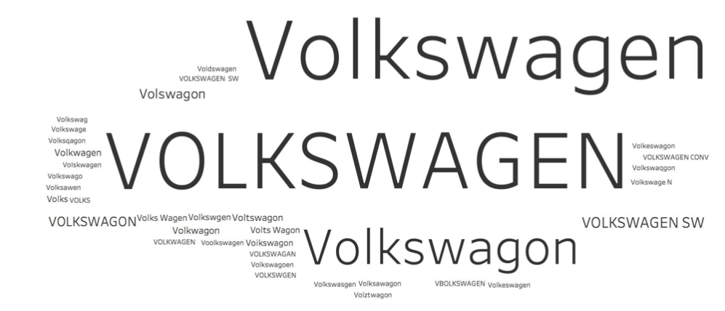
The Effects of Noisy Data

Slide 9
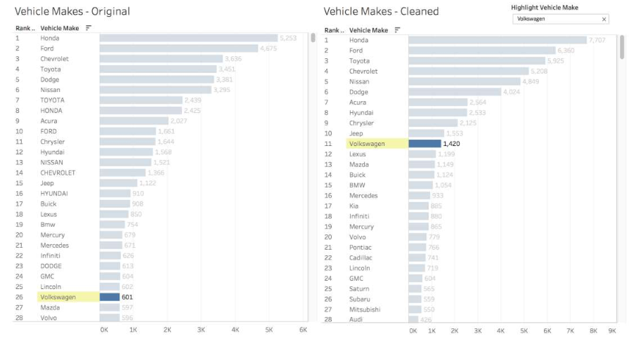
Noisy vs. Clean Data
With the noisy data the Volkswagen brand ranked at position #26.
Once cleaned, that is, once the spelling error of the name were removed the brand moved to position #11.
A huge difference!

